Slide 1
Maroubra Bay Public School
A dynamic, whole-school approach
to improving literacy and numeracy

Slide 2
Challenging beginnings
Nine years ago…
School enrolments were decreasing
Community was mostly low SES families, high needs and high unemployment
Very low expectations and poor outcomes for student achievement
Little parental engagement
Severe behaviour issues

Slide 3
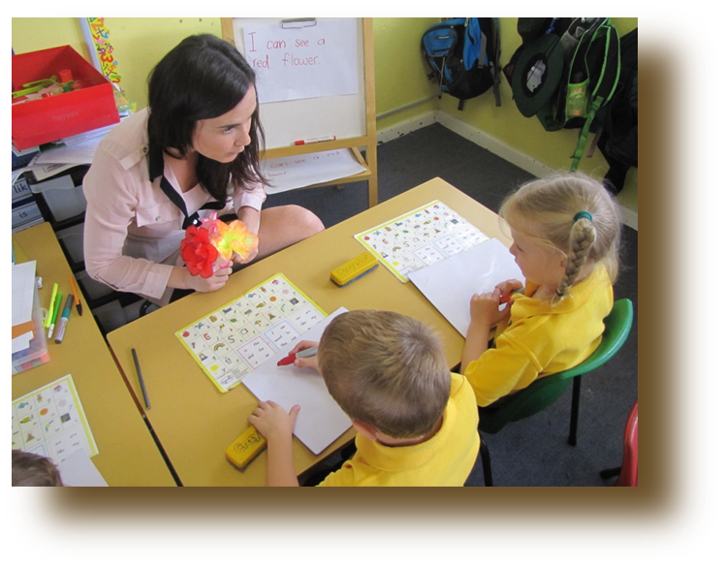
Visible changes
Now…
Improved student outcomes
Increasing enrolments
More diverse school community
Very high expectations from parents and staff for student achievement
Effective parental engagement
Very few behaviour issues

Slide 4
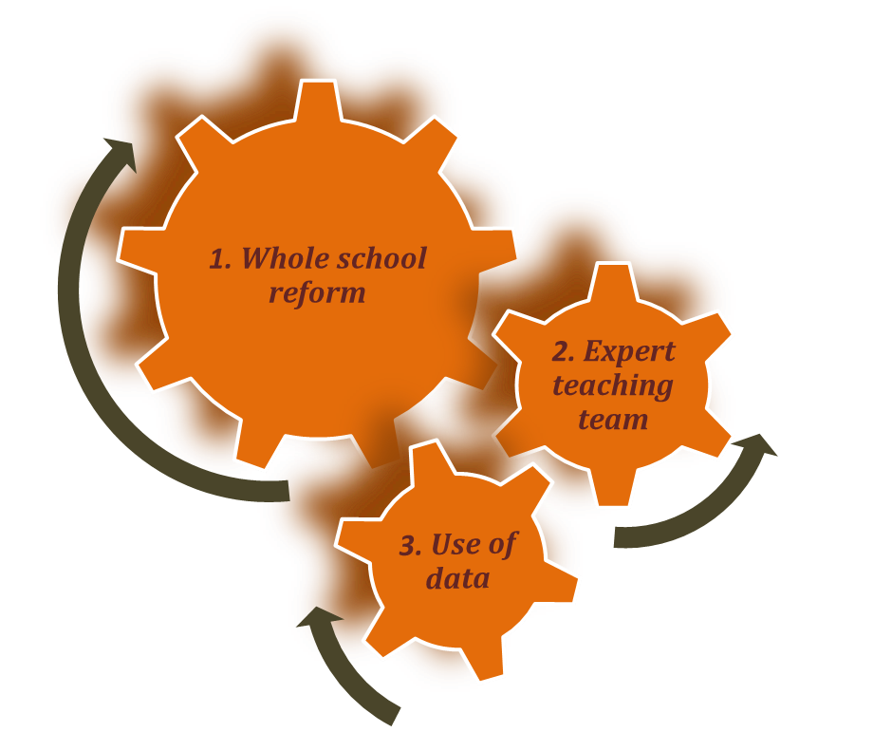
Gearing up for change…what was done?

Slide 5
1. Whole school reform
New Principal communicated commitment to long term, sustainable change across the school
Principal created an effective executive team, including two specialist APs to model, mentor and guide reform
Collaborative planning engages the whole school staff
School reorganised with more classes of smaller size, negotiated with P&C
Teachers typically work with same class for two years
Staff all committed to student outcomes and to achieving and sustaining change
No textbooks – it is all about comprehension and applying learning

Slide 6
Whole school reform (cont.)
Situational analysis supported priority given to literacy
Focus on Reading implemented across whole school
Effective pedagogical approaches used across school:
Language Learning and Literacy (L3)
Best elements of Reading Recovery used across whole school
Similar whole-school approaches used for Numeracy – Targeting Early Numeracy (TEN)
Every student reads to teacher four times a week
Effective approaches still used now – even after NP funding has ceased – demonstrating that change has been embedded

Slide 7
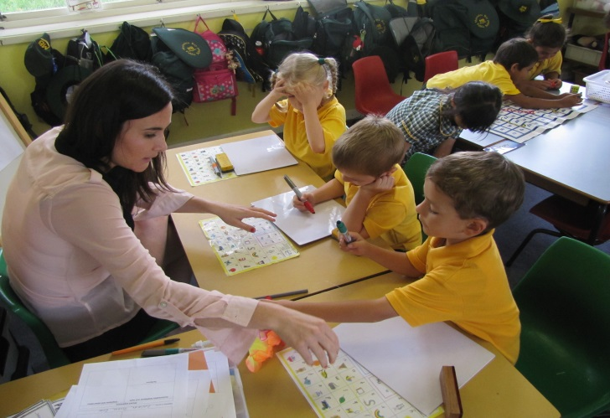
2. Expert teaching team
National Partnership funds were used to appoint two Assistant Principals (non class based)
APs support teachers and teaching through:
Ensuring explicit teaching is a focus throughout the school
In-class teacher mentoring
Regular schedule of team teaching
Collaborative planning
Moderated assessment
Helping to set individual student targets
Assisting in transferring learning from PD courses back into classrooms
Principal regularly takes reading groups

Slide 8
3. Effective use of data
Assessment data directly informs planning at whole school and classroom level
Reading Action Plan to address areas of concern identified initially through situational analysis and benchmarking
All teachers now more confident and competent in collecting, reporting and using data
SMART data analytical tools used regularly
Literacy and Numeracy continuums used to track individual student progress
and to identify next steps to tailor learning experiences for students

Slide 9
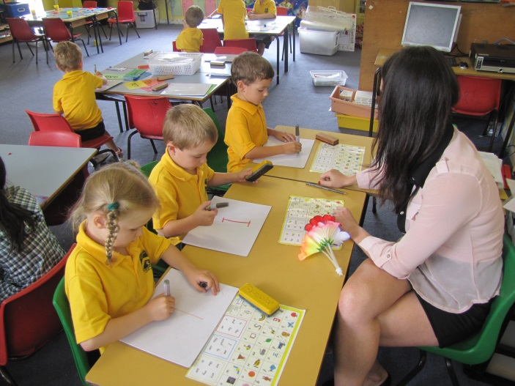
3. Effective use of data (cont.)
Planning Literacy and Numeracy (PLAN Years 3-6) being introduced soon
an extension of Best Start assessments
Will fill in gaps between NAPLAN assessments
values teacher judgements
assisted by software package to help schools track student progress more effectively

Slide 10
Effective use of data (cont.)
Language Learning and Literacy (L3)
L3 developed by DEC to reduce risk of low SES students not achieving expected literacy levels by the end of Kindergarten
Approach is based on research evidence and supported by extensive materials
Schools selected through analysis of Best Start and NAPLAN data, plus poor Kindergarten literacy levels
Maroubra Bay implemented L3 in 2010

Slide 11
L3 (cont.)
Training for teachers occurs over two years
Students are monitored using three sources of data:
Instructional text reading levels
Written vocabulary count
Hearing and recording sounds (from the Reading Recovery Observational Survey)

Slide 12
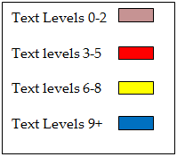
Data tells a great story…
End of year text levels (Kindergarten) changed dramatically after implementation of L3
Before L3 implementation
After L3 implementation
2009
2011
2012

Slide 13
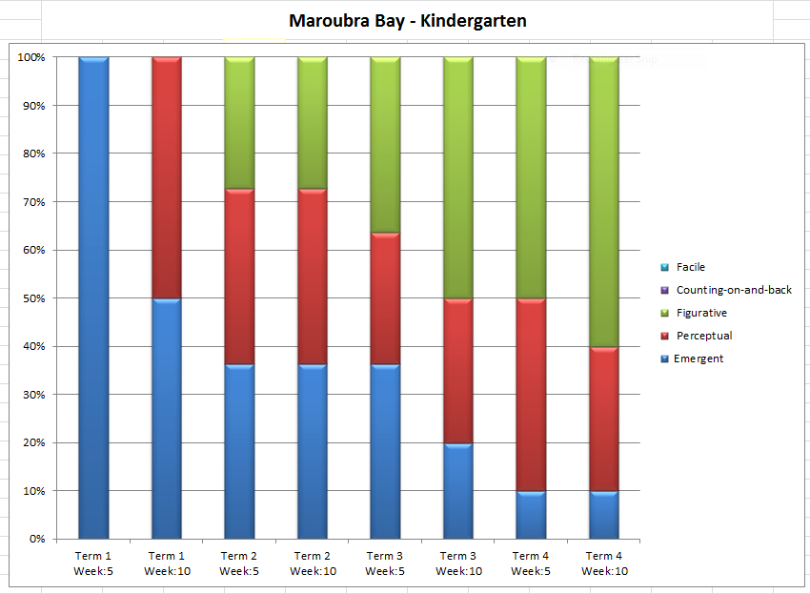
Data from numeracy (TEN) assessments
Assessment results – every 5 weeks – indicate ongoing progress in numeracy
for Kindergarten students

Slide 14
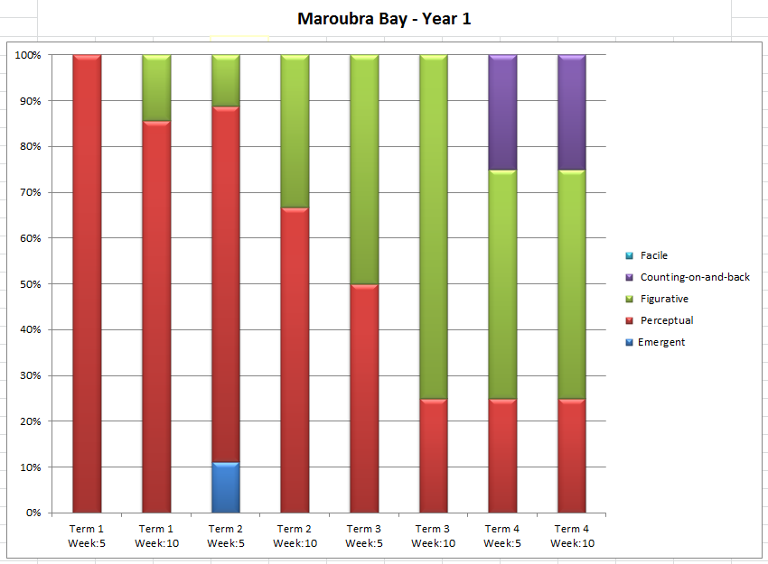
Data from numeracy (TEN) assessments
Assessment results – every 5 weeks – also indicate ongoing progress in numeracy
for Year One students

Slide 15
A change for the better!
Maroubra Bay is now the school of choice for many families with high aspirations
High expectations for student outcomes shared by staff and parents
New initiatives first supported through the Literacy and Numeracy National Partnership have been sustained through enhanced capacity of staff and a school culture of shared responsibility.

Slide 16
Want to know more?
The Principal and Assistant Principals at Maroubra Bay Public School are always pleased to share their stories – please contact the school for further information
Further information on the L3 initiative is accessible under the “Tools and Resources” section of this online resource.
Duncan St Maroubra 2035 Phone: 02 9349 1569

