Slide 1


Data –The Power of One
Sharing Success, Embedding Change
19th May 2011

Slide 2

Notes:
Provide information on school context
530 student population -42% NESB- 8% ATSI

Slide 3
21st Century – The Information Age
In the past several decades, a great deal has changed. The 21st
century has been dubbed the ‘information age’. There has been
an exponential increase in data and information, and technology
has made it available in raw and unedited forms in a range of
media. Like many others in the society, educators are trying to
come to grips with this vast deluge of new and unfiltered
information, and to find ways to transform this information into
knowledge and ultimately into constructive action.
Earl (2005)
Notes:
Using data to support learning has recently become a matter of significant interest in schools.
BST data was previously information that was accessible only by the principal or executive staff. Now more accessible to all – needs also to be accessible to students. An overall mark is not sufficient- students need to have a good understanding of their strengths and areas they need to work on.

Slide 4
What is Data?
According to dictionary.com, data means:
Factual information, especially information for analysis or used to reason or make decisions.
Notes:
Data is not just factual information – it needs to go beyond that.

Slide 5
Collecting, Analysing, Interpreting and Tracking Data
Structures and processes in place for the collection
and tracking of data.
Systematic, whole school
School database for easy access by all staff and tracking of students’ progress
Data presented to staff and community each term to show progress in relation to targets.
Notes:
Data collection needs to be whole school and systematic and not left to the individual teachers – needs to be consistent in the way it is collected and represented. Data base allows accessibility by all and allows for tracking of individual students. Over time it tells a story of the students progress. Data presented at staff meetings each term – data also displayed on community notice boards on the school grounds.s

Slide 6
School Data Tracking-Previous Practice.
Data collected- mainly from assessment of learning. Did not allow timely feedback or give rise to action.
Data highlighted school focus /areas of need.
Analysis of data was mainly at whole school or group level.
Notes:
Although data collection was systematic it mainly represented a snapshot of where the school was in relation to school targets at that particular point in time. It did not give rise to action or provide valuable feedback to teachers and students on specific areas that needed attention. It did not inform the teaching and the learning in the classroom. The data highlighted progress in broader subject areas or compared progress at a group level- particular year groups, writing compared to reading- but did not give direction to learning programs and individual learning plans.

Slide 7
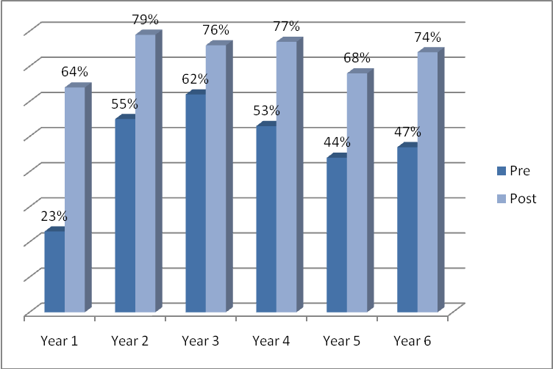
Data- Examples of Data Presented
Pre and Post test comparison for Writing .
School Based
Data
Students Achieving Age Appropriate Benchmark Levels in Reading.
Grade | Term 1 | Term 2 | Term 3 | Term 4
K | - | - | 33% | 54%
1 | 11% | 20% | 38% | 52%
2 | 23% | 38% | 40% | 57%
3 | 20% | 28% | 37% | 52%
4 | 28% | 41% | 54% | 66%
5 | 25% | 34% | 48% | 56%
6 | 33% | 42% | 55% | 67%

Slide 8
NP LN Assessments
Year 3
 | Round 1 | Round 2 | Round 3
Band 1 | 56% | 18% | 9%
Band 2 | 29% | 33% | 24%
Band 3 | 9% | 30% | 26%
Band 4 | 4% | 8% | 19%
Band 5 | 3% | 11% | 23%
External
Data

Slide 9

Data Rich, Information Poor
Limited explicit connection between teachers' practices in the classroom and the school's directions and goals.
Notes:
After examining the type of data the school collected and how it was being used, staff discovered that they were very rich in data but very poorly informed as to what needed to be done at the classroom and individual level to drive the learning.

Slide 10
Using Data to Generate Change.
Data used constructively not just for accountability or for sorting and labelling
students.
Collection of data and evidence needs to be an integral part of both the school planning process and of the teaching and learning.
Data needs to give rise to action!!!!
Notes:
Data had been used to track progress at school level. The collection of data allowed staff to meet accountability purposes and offered a sense of assurance that ‘all was well’. The data analysis was superficial, failing to provide clear and direct links between whole school directions, planning and processes with the powerhouse of learning improvement which is the teaching and learning in the classroom.

Slide 11
Impacting on Student Learning
School Target- 75% of all students achieving grade appropriate Reading Benchmarks.
Percentage Achieving | 2007 | 2008 | 2009 | 2010
Term 1 | * | 23% | 19% | 41%
Term 2 | 16% | 33% | 34% | 48%
Term 3 | 36% | 54% | 51% | 55%
Term 4 | 55% | 59% | 62% | 68%
Notes:
The shift to interpreting data at an individual level and using explicit success criteria to identify areas of need for individual students led to a significant improvement in student learning outcomes.

Slide 12
Planning for Change
For assessment data to have a significant impact there had to be change.
‘ Teacher Enquiry and Knowledge Building Cycles’ –professional dialogue/professional development.
A better understanding of skills and knowledge required at each stage of development
Linking assessment to outcomes -Rubrics-specific criteria
Learning goals in IEPs are clear to both teacher and student
Notes:
The results reinforced the need to question and scrutinise the way data is used and how assessment is linked to desired outcomes. Teachers used the teacher and knowledge building cycles to do this, questioning current practice and its effectiveness. Teachers realised the importance of having a good understanding of the content being taught and how they were going to teach it. General outcomes were broke down to specific skills and knowledge that students were expected to achieve- providing consistent and explicit success criteria that was known to both the teachers and students. Learning outcomes were directly linked to the assessment tasks and marking rubrics clearly displayed these skills. The rubric is used as an individual learning continuum for each student giving direction to what needs to be done to achieve the next skill level. The Individual Learning Plans are then based on strengthening skill areas identified by the marking rubrics. The ILPs and marking rubric work together to identify areas of need and give direction to the learning of the student-where to next. Explicit success criteria and effective assessment that links to outcomes needs to be a complete package if significant improvement in learning is desired.

Slide 13
Planning for Change
Providing explicit feedback for areas of improvement
Pre an post testing
Strategic resourcing
Notes:
The effect of feedback is paramount- not just feedback to teachers of how their students performed, but back to the student. It is their learning yet they are the ones that are consulted or informed the least about the teaching and learning that they take part in. Staff valued the importance of using both pre-testing and post testing as part of their assessment and ensured that assessment as learning informed their weekly teaching program.

Slide 14
Using Data at the Classroom Level
Data at the classroom level improved teachers’ understanding of student needs.
Classroom data- not restricted to formal assessment of learning but included assessment for learning and as learning.
Variety of learning data - observations, students' responses to questions in the classroom, rubrics, checklists, test scores and other measures of student work.
Notes:
More emphasis on a variety of data/evidence to inform teaching.

Slide 15
Using Rubrics- Learning Tool
Provides a whole school Reading Comprehension assessment task.
Provides ‘Consistent Teacher Judgment’ when assessing.
Raises student expectations and understanding of skills
Provides an assessment tool to track and measure progress at student level, group level as well as whole school level.
Identifies areas of need in Comprehension which assists future planning.

Slide 16
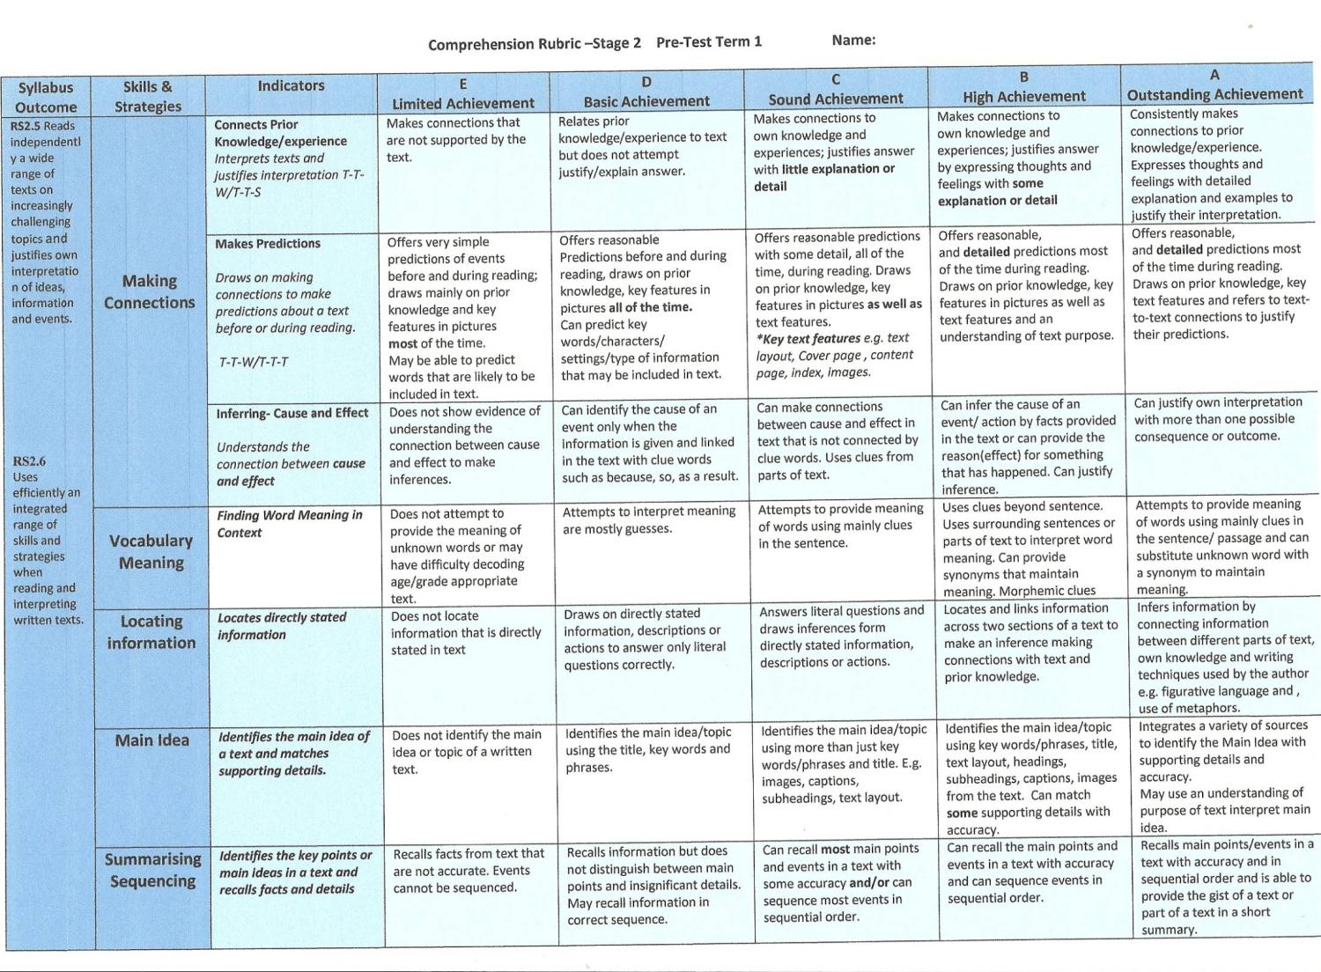
Rubric- Comprehension
Notes:
Used against a pre and post assessment task. Identifies areas of need and shows an achievable gap between actual and desired performance. The criteria on the rubric was determined by the analysis of smart data. Each criterion was identified as a skill focus for both Year 3 and Year 5 students in NAPLAN 2010.

Slide 17
Acting on Data – Asking Questions

Slide 18
Feedback for Improvement
The main requirement is that feedback should direct attention to an achievable gap between desired and actual performance.
(Visscher 2002)
Notes:
Important – “achievable gap”

Slide 19
Student Feedback

Slide 20

Sustaining Change
Whole school processes and structures
Assessment Policy-assessment embedded
Feedback to students, parents and community
Whole grade/stage collaborative planning time
Promoting a Culture of Learning
Team teaching/classroom observations/lesson feedback
Regular sharing of resources and effective practices
LST – sharing expertise
Learning from others- School Networks
Professional development based on teacher needs
Shared responsibility and accountability
Shared vision, beliefs and understandings
High standards and expectations
Common goals and clear directions

Slide 21
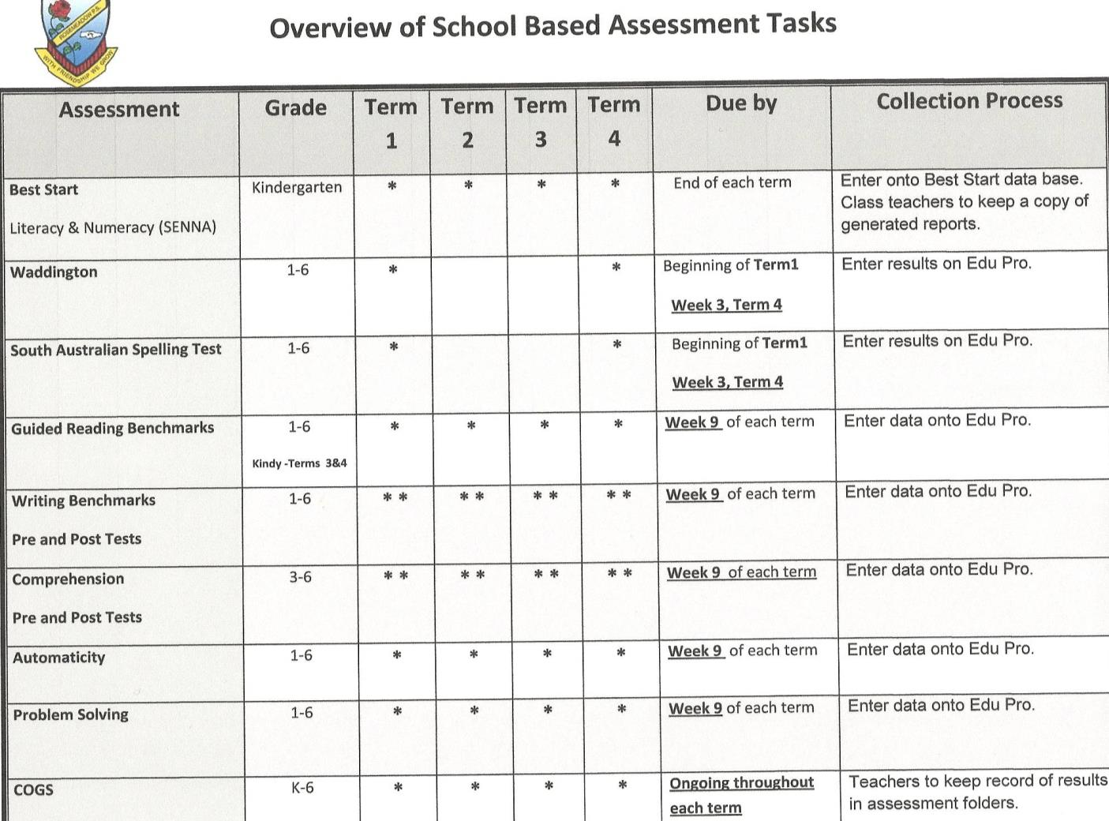

Slide 22


The Power of One
By locating evidence in the classroom … we can influence the major agent that influences student and learning – the teacher
Allen (2005)

Slide 23
How will you make a difference?

